Slide 1
Chapter 1
MATLAB Primer
This introductory chapter is relatively short and has as its main objective the introduction of MATLAB® to the reader. This early introduction has the purpose of familiarizing the reader with the basic operations of MATLAB so that the program may be used throughout the book to support the mathematical analysis.

Slide 2
Desktop Layout
The screen shown on the next slide is based on Version7, Release 14.
The Student Version of MATLAB comes with the Symbolic Mathematics Toolbox and the program Simulink. All examples in the text should work with the Student Version

Slide 3
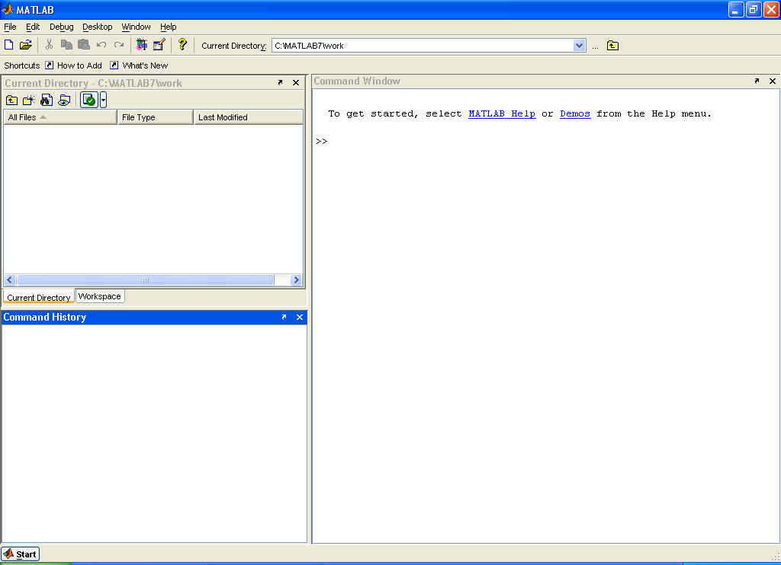

Slide 4
Prompt
MATLAB automatically inserts the prompt >> at the beginning of each line in the Command Window of the Professional Version. The corresponding prompt for the Student Version is EDU>>. We will assume the shorter prompt of the Professional Version throughout the text and the presence of the prompt on a line will alert the reader to the fact that a MATLAB command and possible results will follow.

Slide 5
Command Window
The Command Window may be used on an interactive basis by simply typing in the commands after >> for the Professional Version or after EDU>> for the Student Version on a line-by-line basis. Depress Enter on the keyboard after each line is entered, and any results generated by the command will immediately appear on the screen unless the addition of a semicolon has suppressed the display or unless the command is part of a sequence.

Slide 6
Notational Conventions
In the MATLAB examples, we will usually display the results exactly as they appear on the screen. This means that the type style will be different from the standard mathematical style in the remainder of the book, but the symbols should be perfectly clear. Standard mathematical notation includes italicized symbols with subscripts and/or superscripts but MATLAB notation will be non-italicized without subscripts or superscripts.

Slide 7
Command Window versus M-files
The Command Window will allow you to work in a manner similar to that of a calculator. You can enter a command and see the numerical results immediately. The important thing is that it is interactive. This is in contrast to the writing of M-files, which is performed in a different window. An M-file is a form of computer program.

Slide 8
Clear Commands
Clearing the screen:
>> clc
Clearing all variables:
>> clear
Clearing a variable x:
>> clear x

Slide 9
Spacing
Blank spaces between distinct sections of a command line may be used to avoid a “crowded” appearance provided that they don't disrupt a particular command function or number. Thus, x=5 , x = 5, and x = 5 are all acceptable. However, if the number is 51, you will get an error message if you try to put a space between the 5 and the 1. Likewise a variable x1 cannot be expressed as x 1.

Slide 10
Basic Arithmetic Operations
In many of the slides that follow, basic arithmetic operations will be employed using simple numbers to illustrate the manner in which the command window can be used in much the same way as a calculator. To save space on the slides, many of the blank lines that appear on the computer screen will be eliminated.

Slide 11
Entering Numbers
>> 5
ans =
5
>> x = 5
x =
5
>> y = 3
y =
3

Slide 12
Addition and Subtraction
>> z1 = 5 + 3
z1 =
8
>> z1 = x + y
z1 =
8
>> z2 = y - x
z2 =
-2

Slide 13
Checking on the Variables
>> whos
Name Size Bytes Class
x 1x1 8 double array
y 1x1 8 double array
z1 1x1 8 double array
z2 1x1 8 double array
This information may also be found in the Current Directory window.

Slide 14
Multiplication
Multiplication is performed by placing an asterisk (*) between the numbers.
>> z3 = 5*3
z3 =
15
>> z3 = x*y
z3 =
15

Slide 15
Division
Division of x by y is performed as follows:
>> z4 = x/y
z4 =
1.6667
An alternate form is as follows:
>> z4 = y\x
z4 =
1.6667

Slide 16
Exponentiation
Exponentiation is performed by using the symbol (^).
>> z5 = x^2
z5 =
25

Slide 17
Suppressing the Listing of Results
If it is desired to perform a computation and not show it on the screen, the command should be followed by a semicolon (;). For example,
>>z6 = y^x;
The value is in memory and may be seen by entering the variable name.
>> z6
z6 =
243

Slide 18
Entering in Exponential Form
A microwave frequency of 15 GHz (1 GHz = 10⁹ Hz) may be entered as
>> f = 15e9
f =
1.5000e+010
Boltzmann’s constant k = 1.38x10⁻²³ J/K may be entered as
>> k = 1.38e-23
k =
1.3800e-023

Slide 19
Square Root
>> z7 = sqrt(x)
z7 =
2.2361

Slide 20
Hierarchy
Without parentheses, the normal hierarchy of arithmetic operations is exponentiation, multiplication, division, addition, and subtraction. Parentheses may be used to change the order. When in doubt, it is prudent to add parentheses to ensure that the order is performed properly. The process of placing parentheses within parentheses is called nesting.

Slide 21
Consider the algorithm shown below.
1. Add 3 to x.
2. Square the result of step 1.
3. Multiply the result of step 2 by 6.
4. Add 8 to the result of step 3.
5. Take the square root of step 4 and the value obtained is y.

Slide 22
The algorithm may be implemented by MATLAB on a step-by-step basis.
>> u1 = 3 + x ;
>> u2 = u1^2 ;
>> u3 = 6*u2 ;
>> u4 = 8+u3 ;
>> y = sqrt(u4)
y =
19.7990

Slide 23
The algorithm may be implemented in one step using nesting.
>> y = sqrt(8+(6*((3+x)^2)))
y =
19.7990

Slide 24
Some MATLAB Constants
>> pi
ans =
3.1416
>> eps
ans =
2.2204e-016
>> sqrt(-1)
ans =
0 + 1.0000i
The next slide shows 4 ways to enter an imaginary number.

Slide 25
>> 5i
ans =
0 + 5.0000i
>> 5j
ans =
0 + 5.0000i
>> i*5
ans =
0 + 5.0000i
>> j*5
ans =
0 + 5.0000i

Slide 26
Division by Zero
Divison by zero will either yield Inf (“infinity”) or NaN (“not a number”) depending on the form. As examples, if the command 1/0 is entered, the result is Inf, and if the command 0/0 is entered, the result is NaN.

Slide 27
Programming with M-Files
A computational procedure may need to be repeated for more than one set of input data and/or the code consists of a relatively long list of commands. In this case, it is usually more convenient to develop an M-file, which may be saved and used as often as desired. An M-file (or M-file script) is a MATLAB-based computer program for performing a particular analysis.

Slide 28
Programming with M-Files (Continuation)
Any of the commands that may be applied in the Command Window may be combined into an M-file program. Instructions for accepting input data for different cases may be added to the programs. To use the MATLAB editor, left-click on File and left-click on New. After preparing the file, it should be saved with the extension .m. Details are provided in the text.

